Slide 1
Washington Consumer Insights Dashboard
DMA Trends: 2019-2025

Slide 2
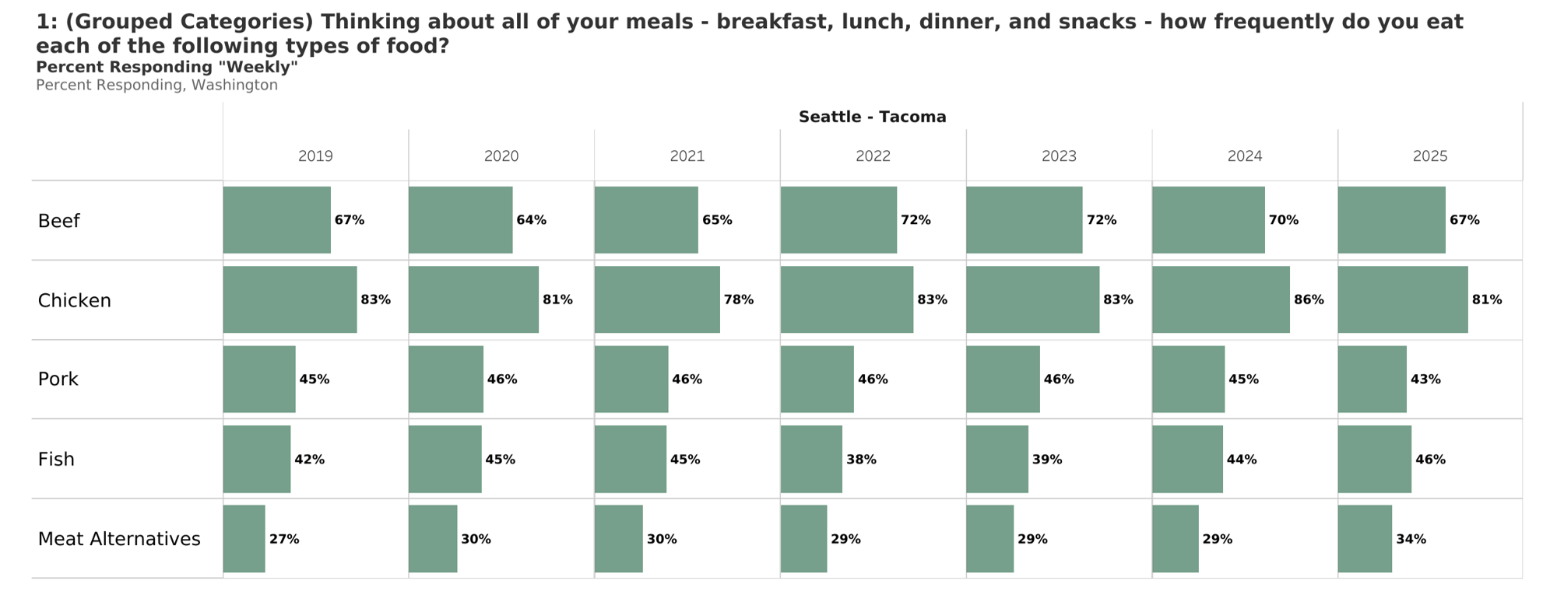
Weekly+ Protein Consumption

Slide 3
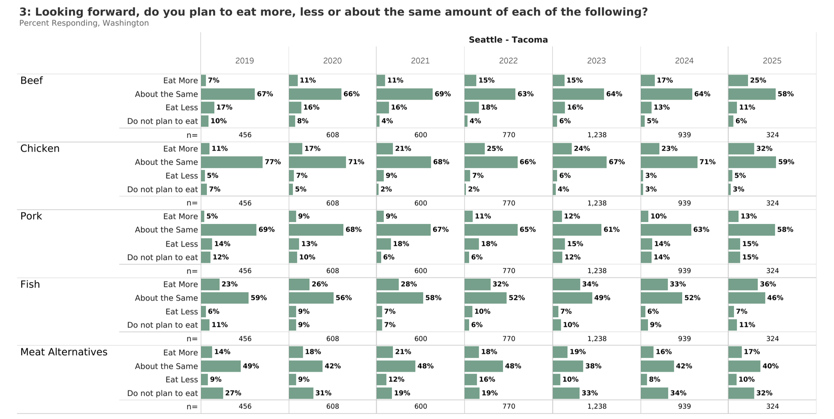
Future Protein Consumption

Slide 4
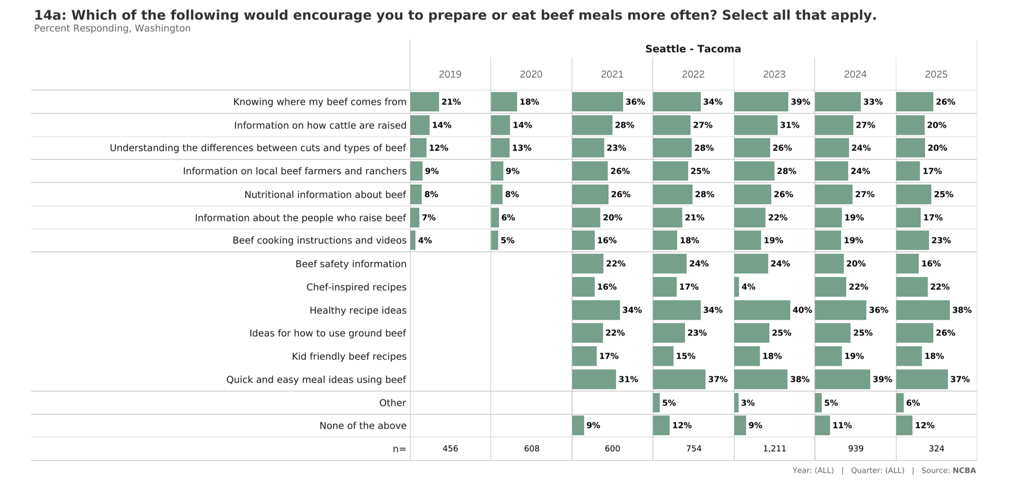
Encourage Beef Consumption In Future

Slide 5
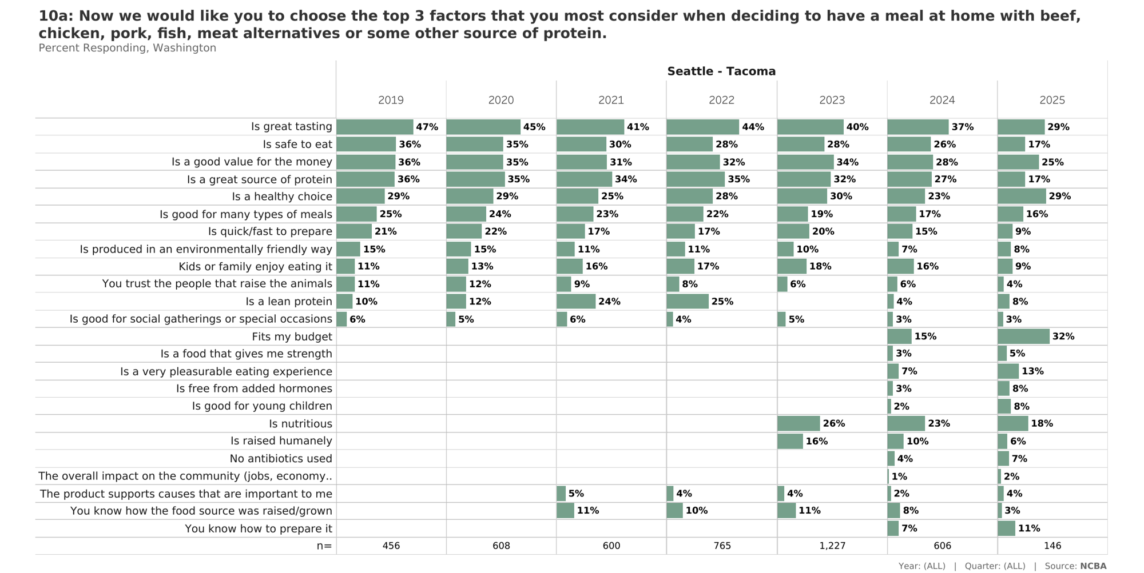
Top 3 Considerations for Protein at Home

Slide 6
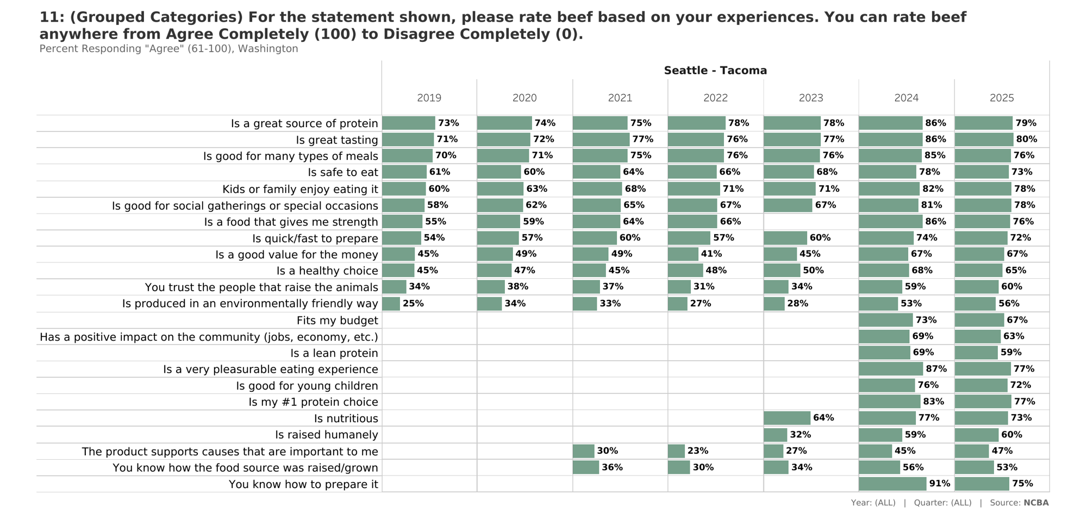
Beef Attributes: Agree (Top 4 Box)

Slide 7
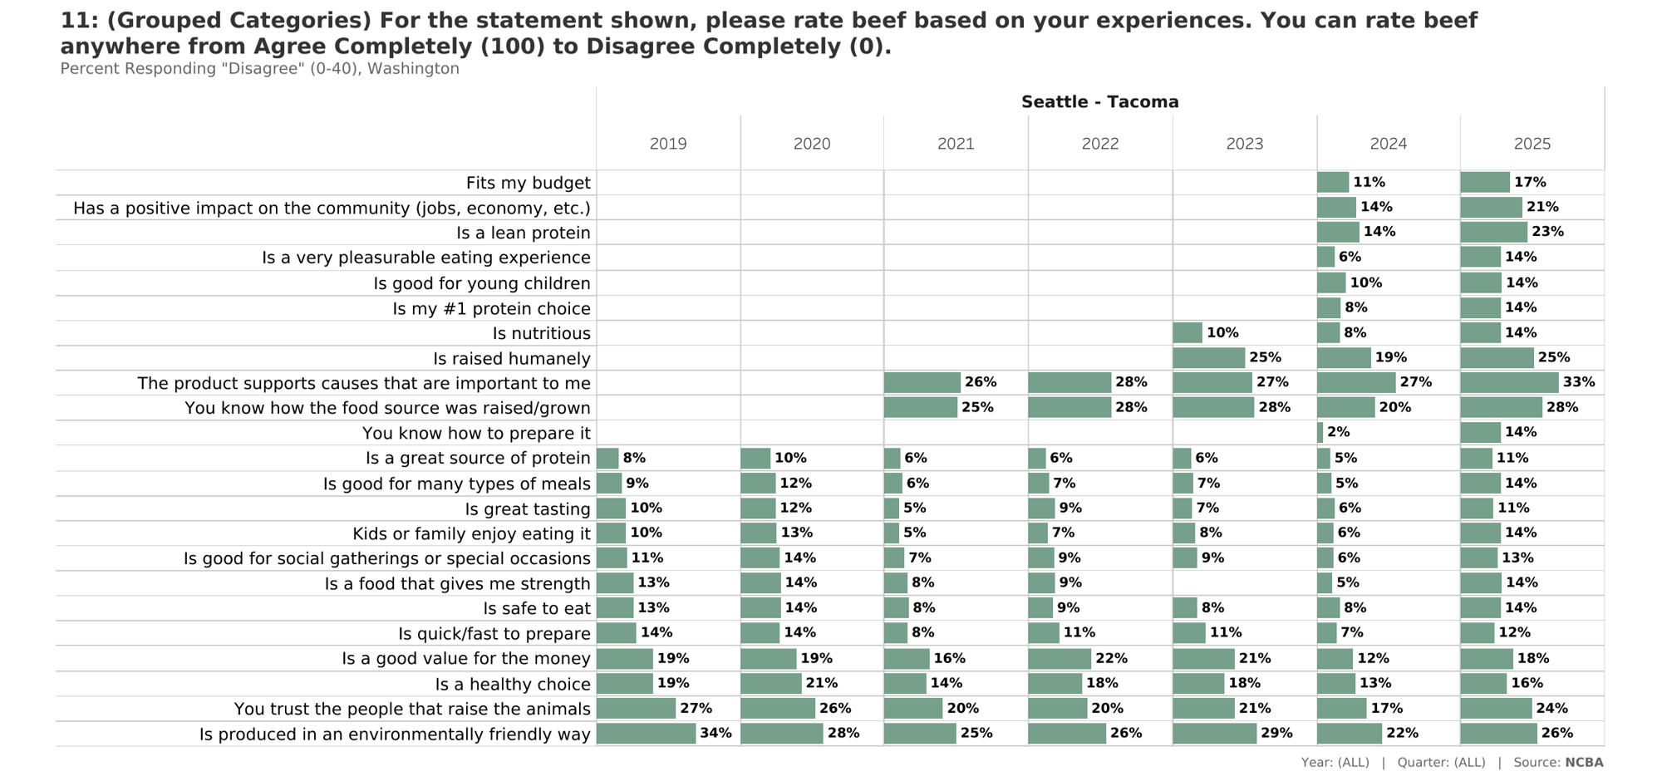
Beef Attributes: Disagree (Bottom 4 Box)

Slide 8
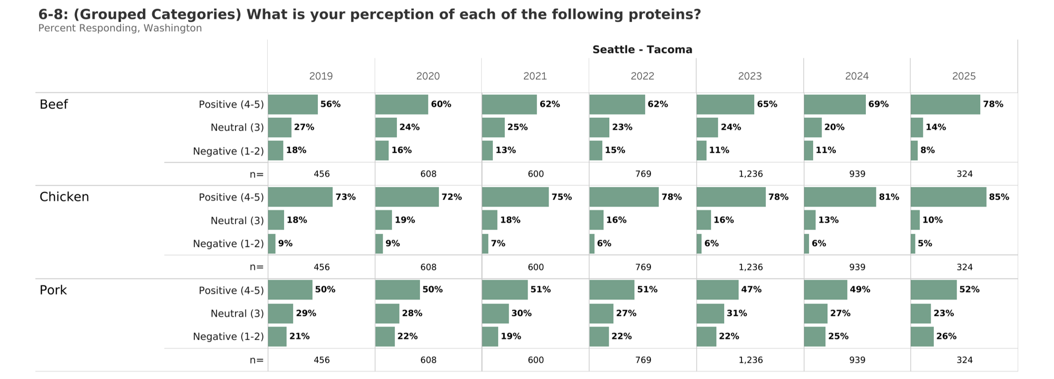
Overall Perceptions

Slide 9
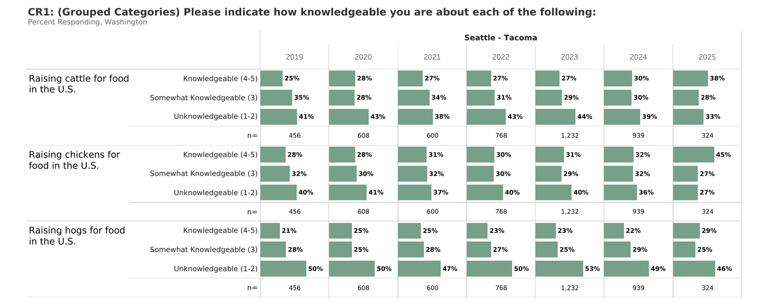
Production Knowledge

Slide 10
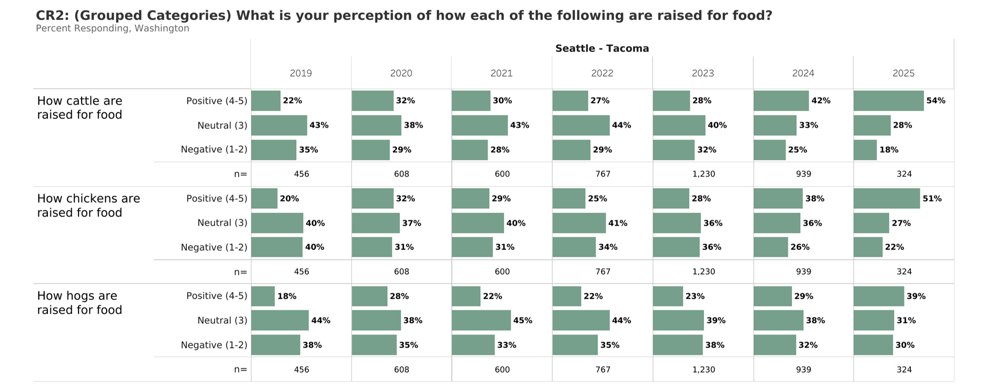
Production Perceptions

Slide 11
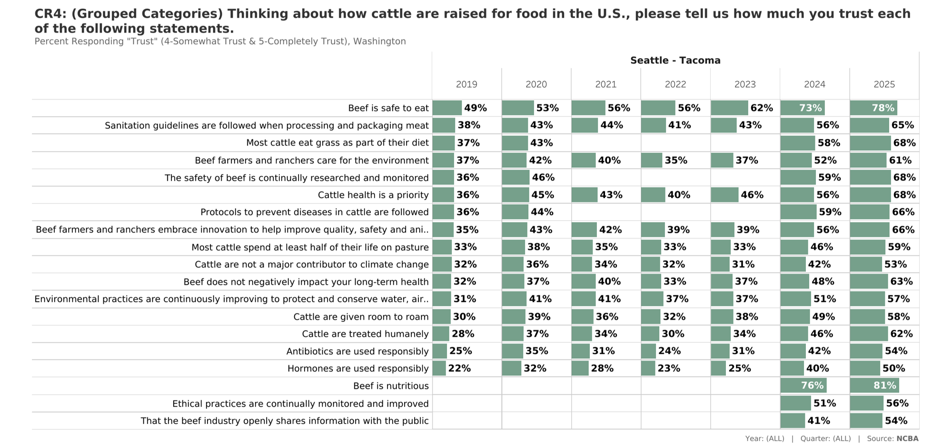
Trust Metrics: How Cattle are Raised for Food: Trust (Top 2 Box)

Slide 12
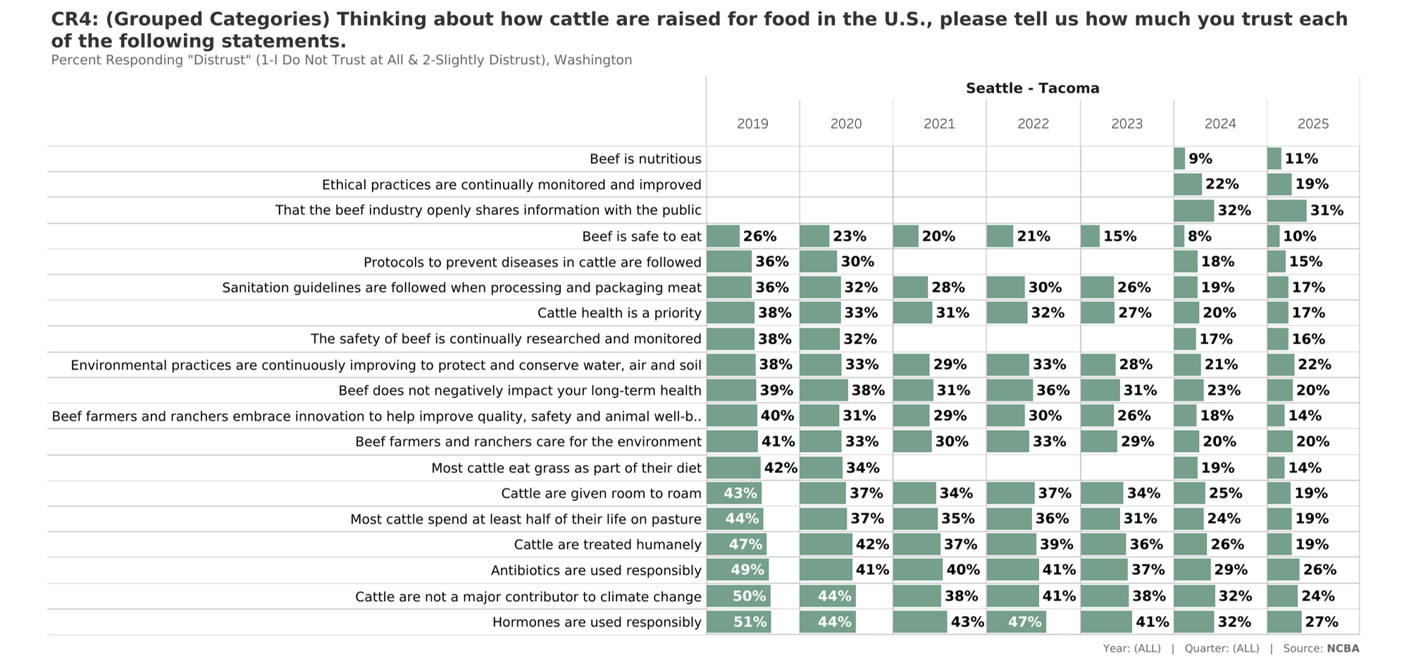
Trust Metrics: How Cattle are Raised for Food: Distrust (Bottom 2 Box)

Slide 13
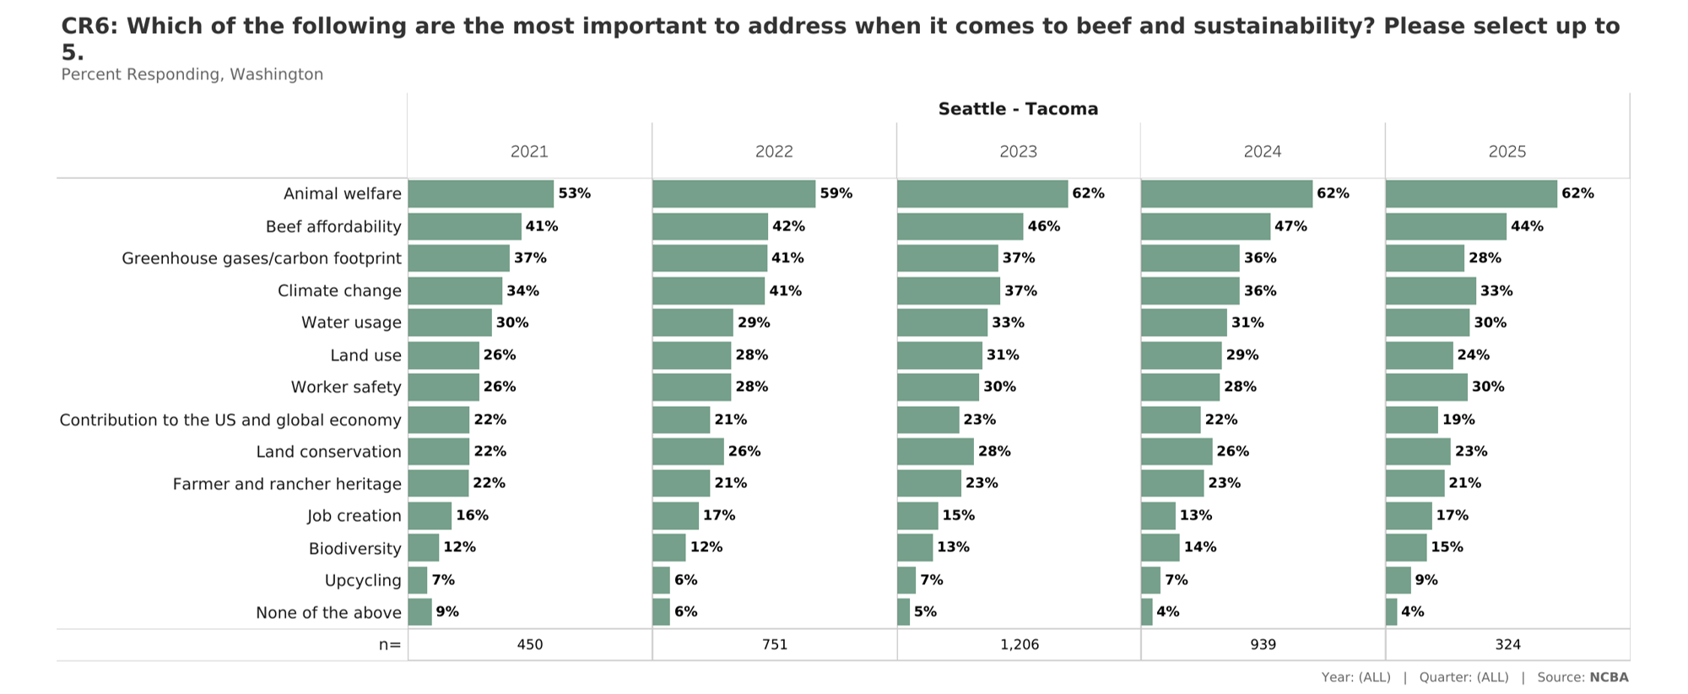
Most Important Topics Related to Beef & Sustainability

Slide 14
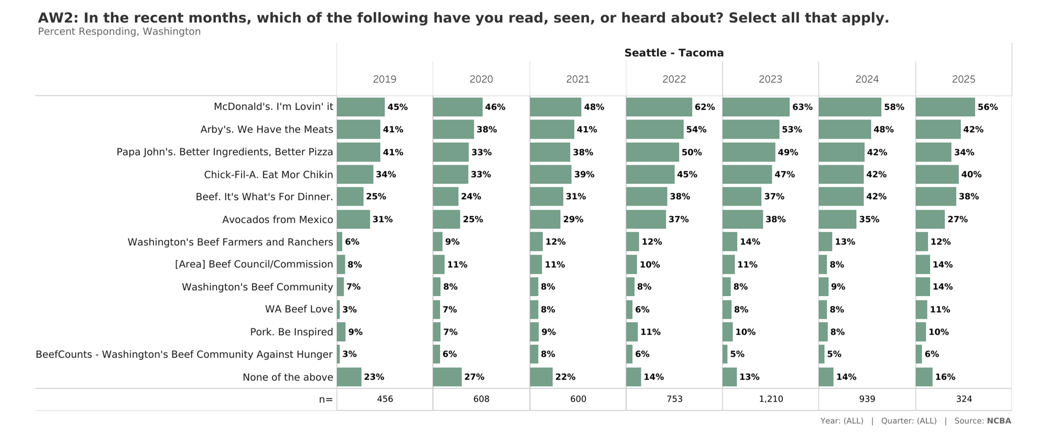
Brand Awareness: State-Specific

Slide 16
Appendix

Slide 17
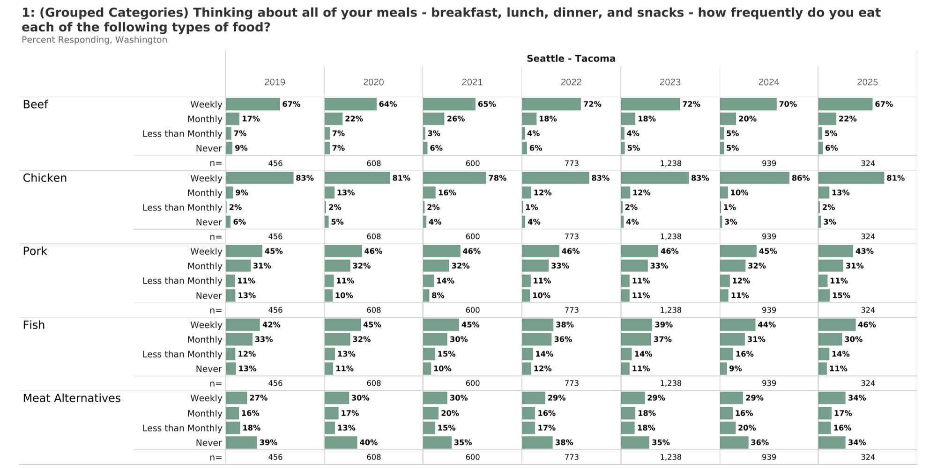
Protein Consumption

Slide 18
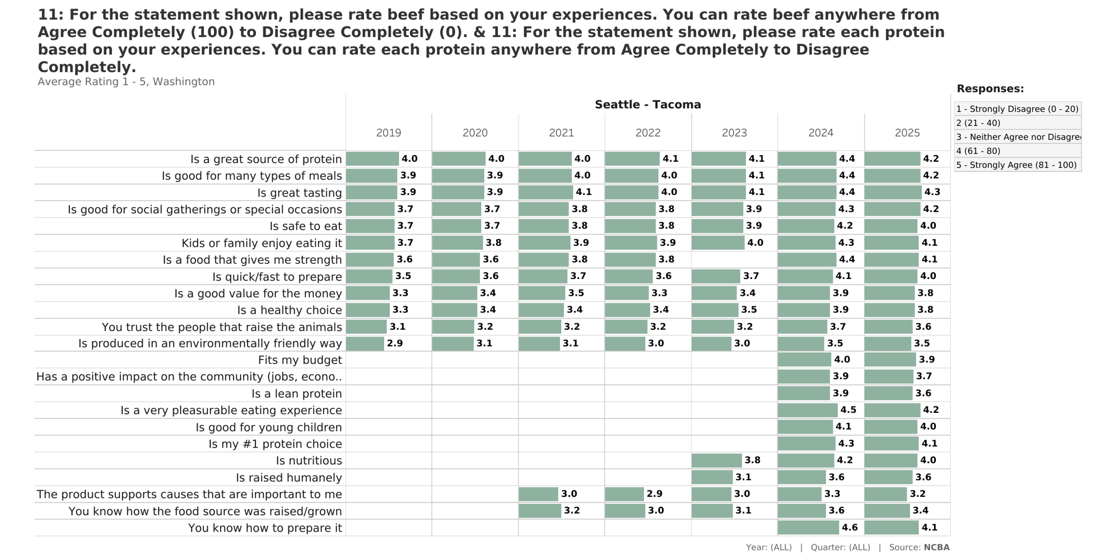
Beef Attributes: Average Rating

Slide 19
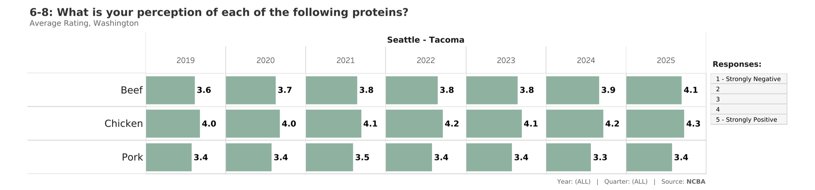
Overall Perceptions: Average Rating

Slide 20
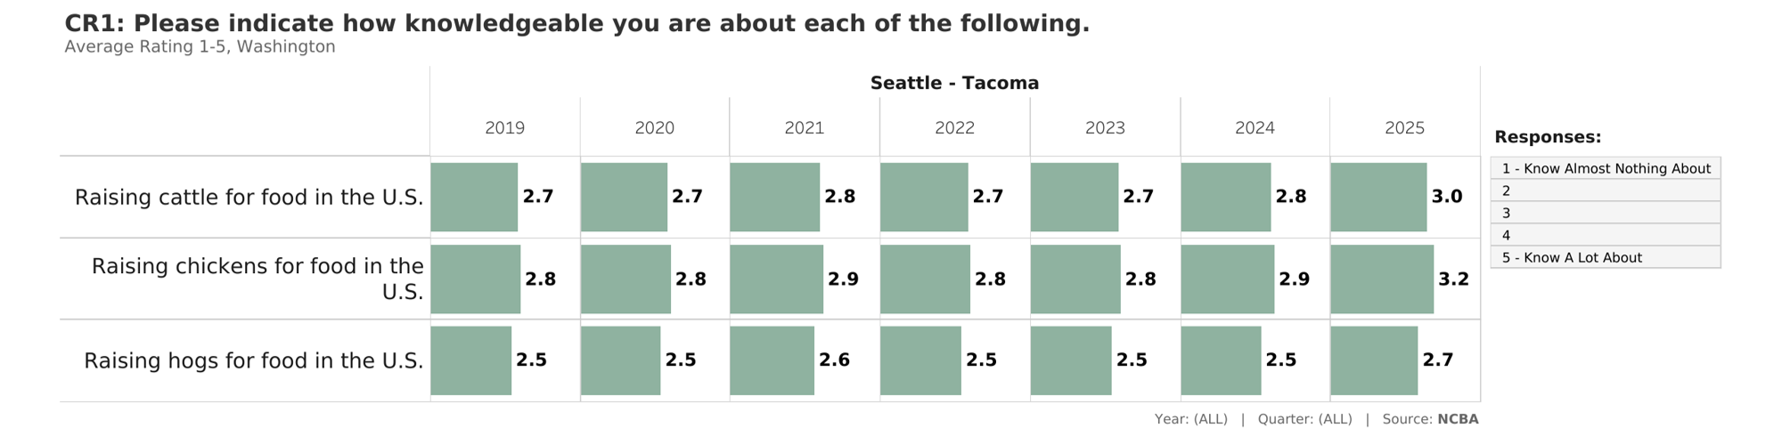
Production Knowledge: Average Rating

Slide 21
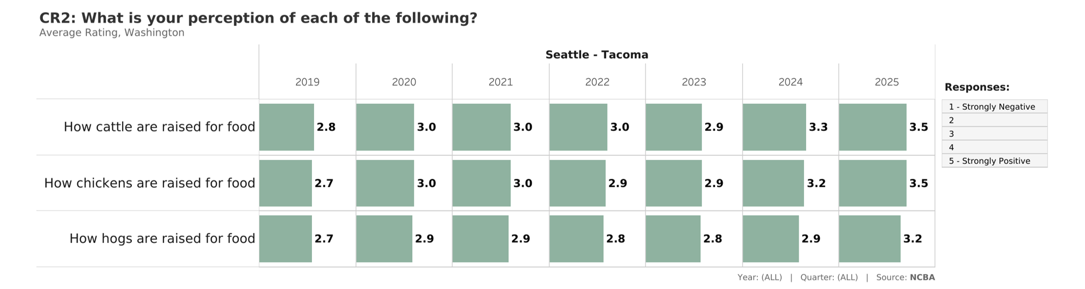
Production Perceptions: Average Rating

Slide 22
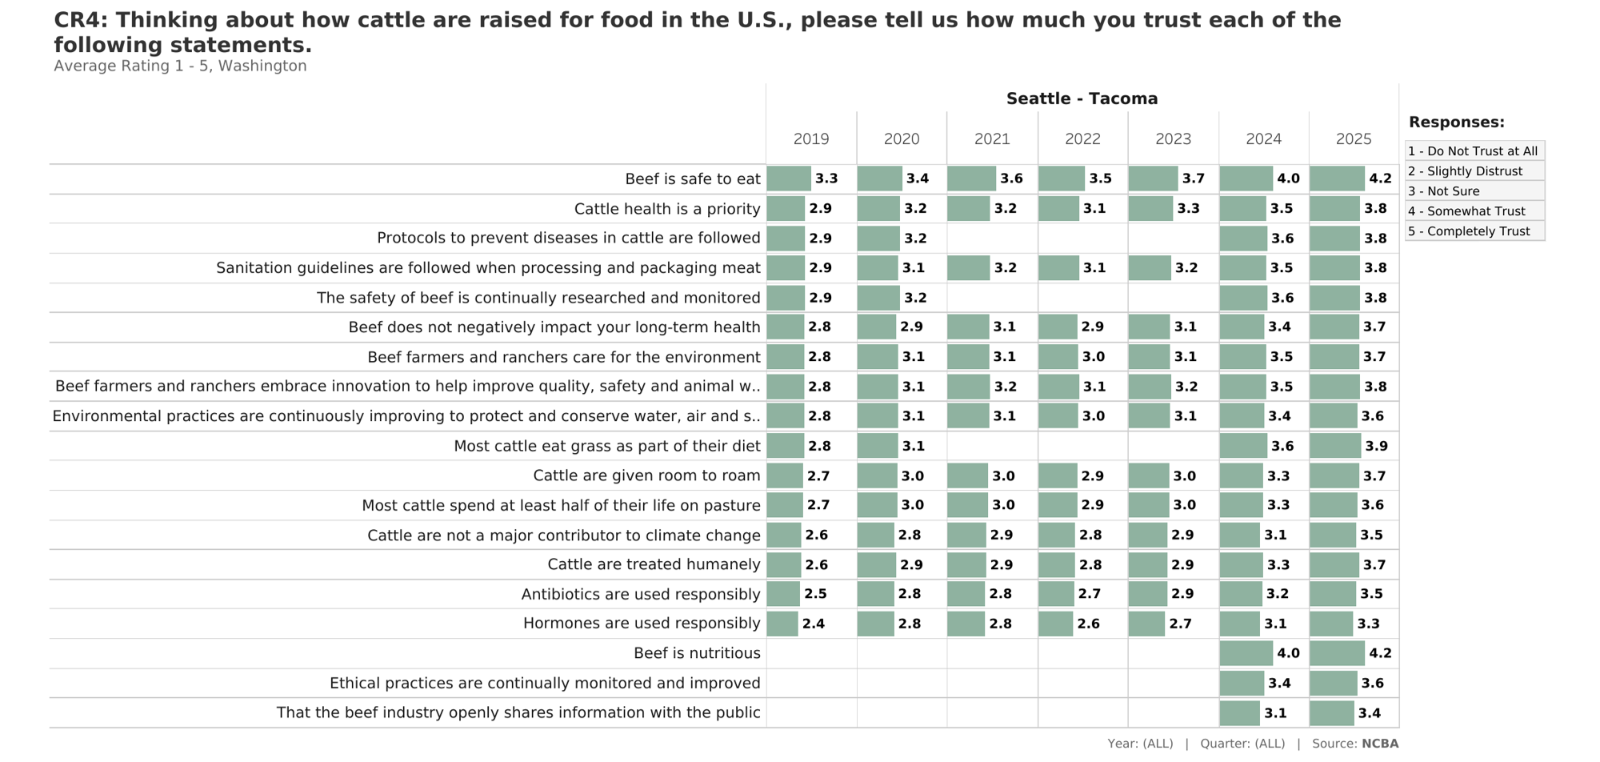
Trust Metrics: How Cattle are Raised for Food: Average Rating

