Slide 1
Washington Consumer Insights Dashboard
2025 Annual Report

Slide 2
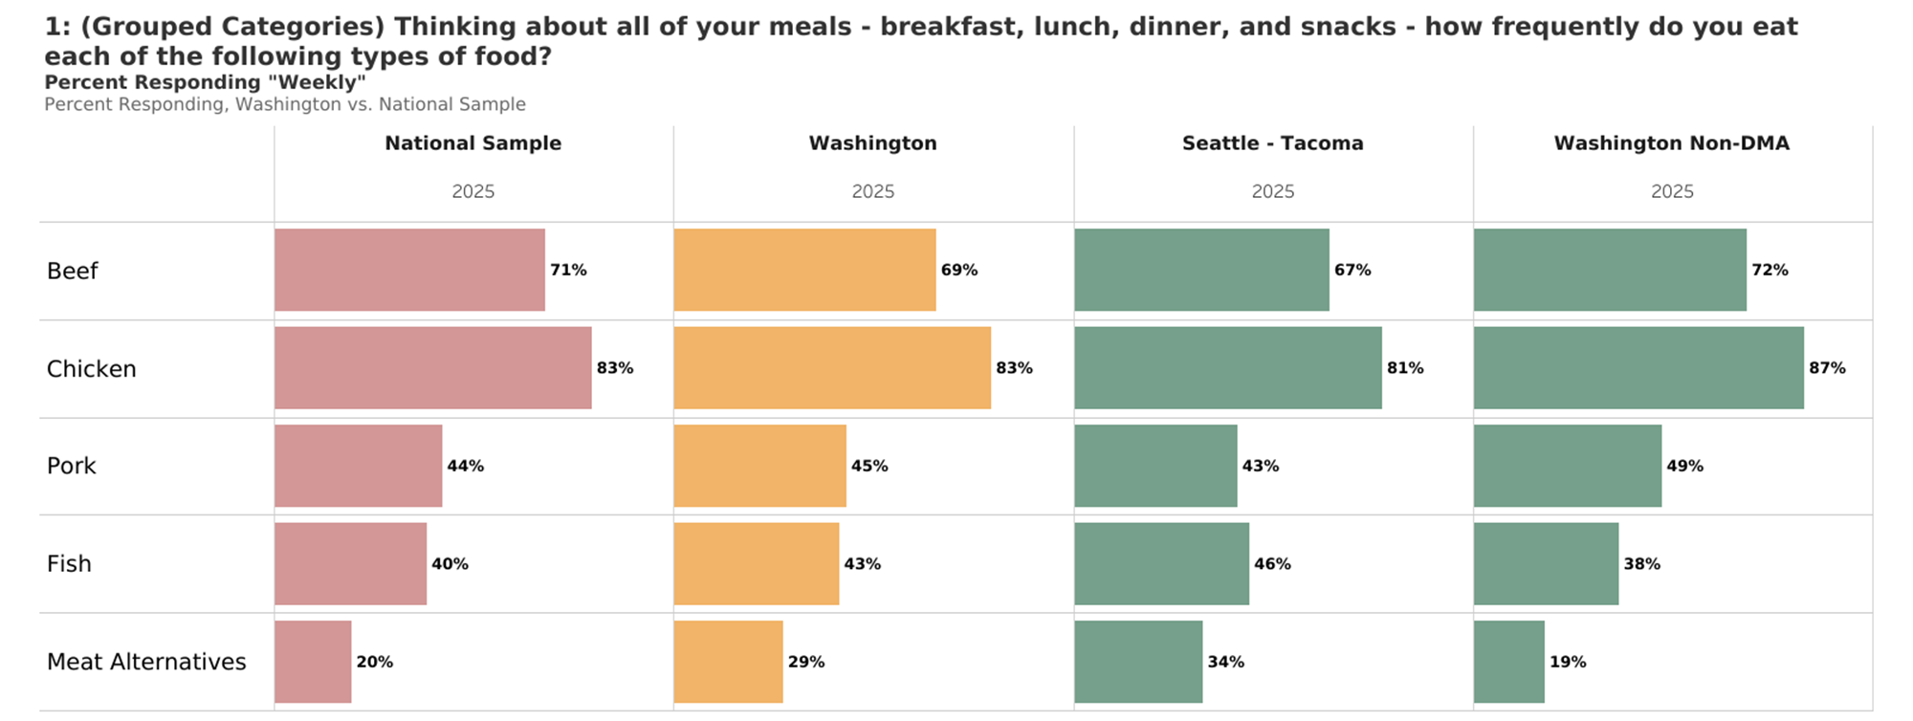
Weekly+ Protein Consumption

Slide 3
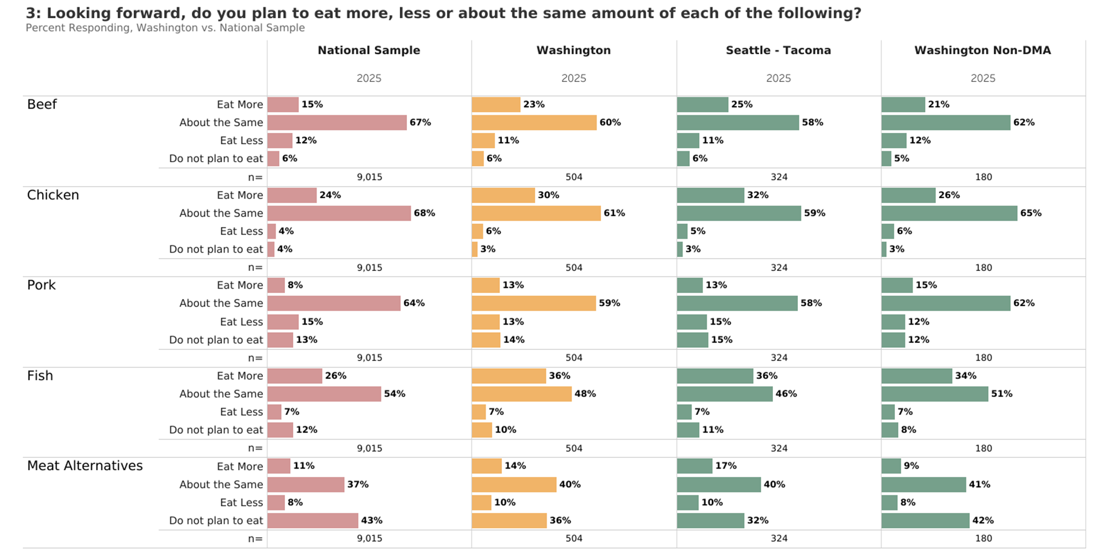
Future Protein Consumption

Slide 4
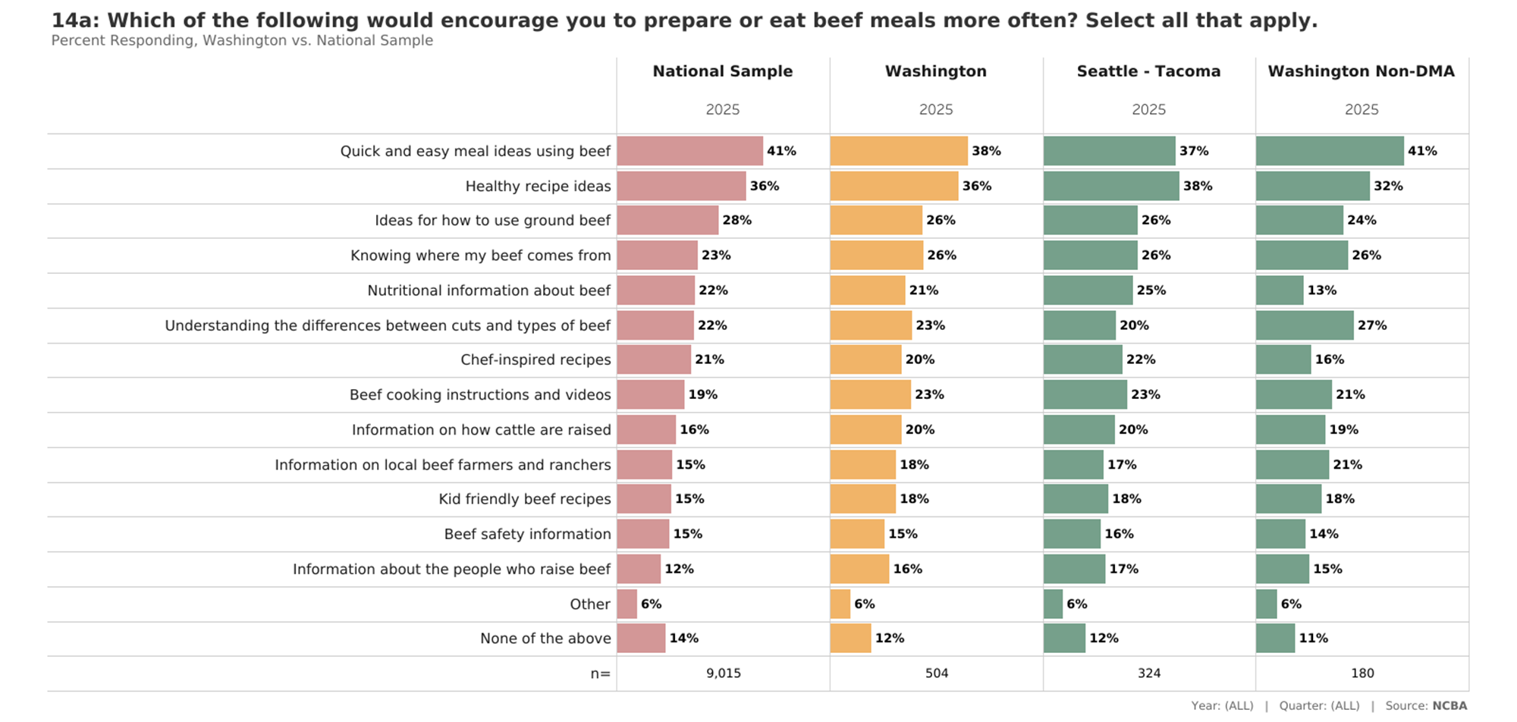
Encourage Beef Consumption In Future

Slide 5
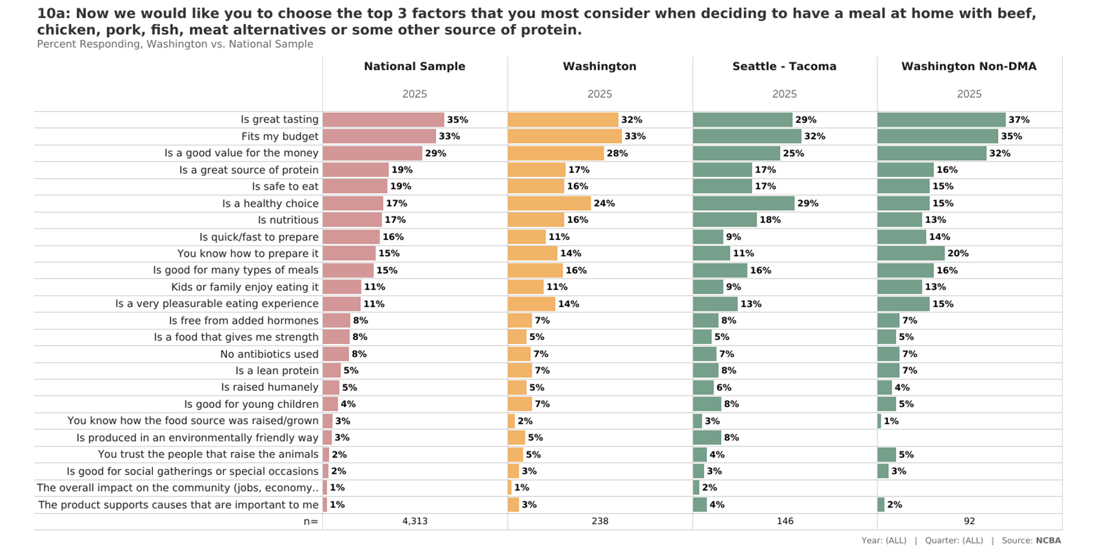
Top 3 Considerations for Protein at Home

Slide 6
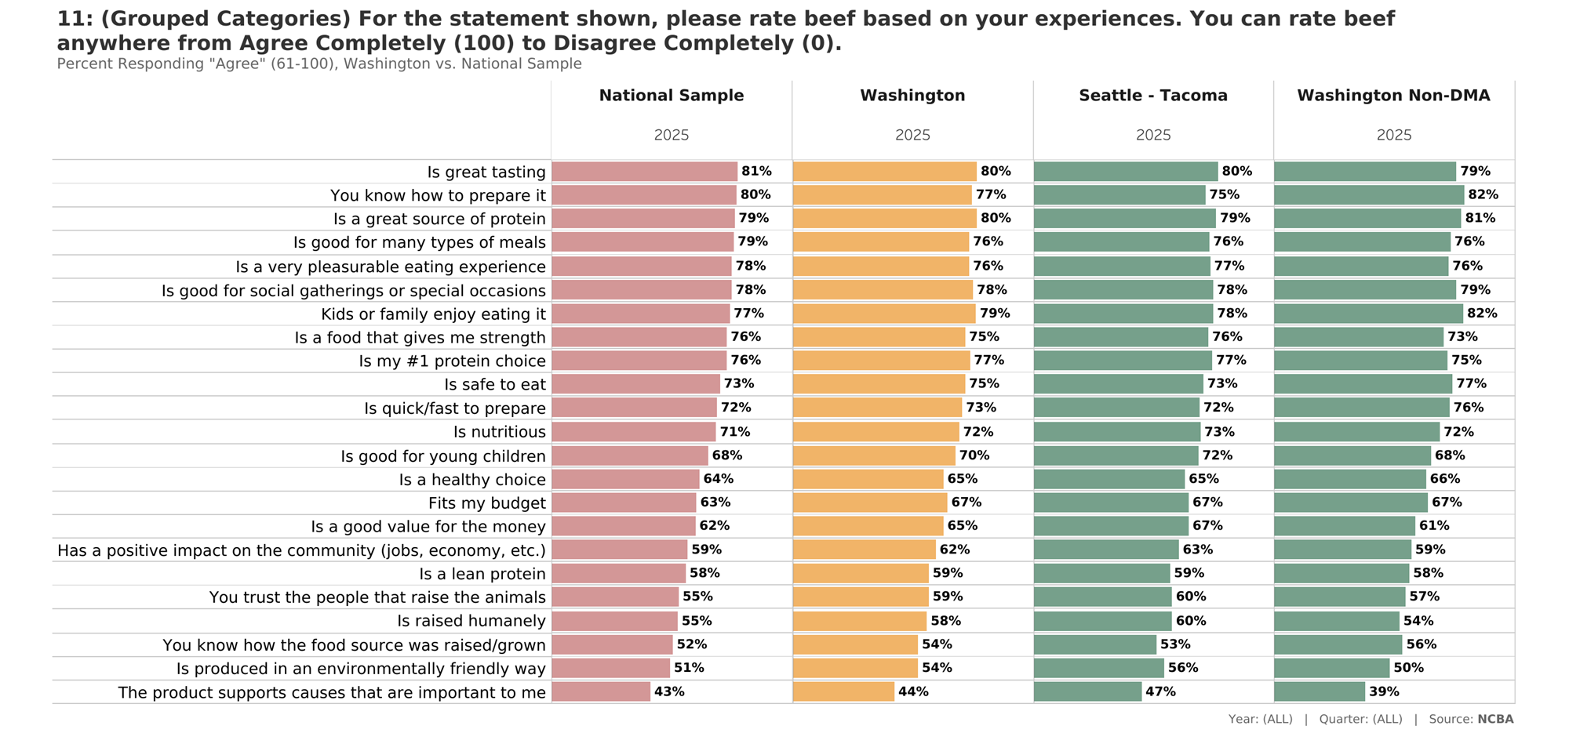
Beef Attributes: Agree (Top 4 Box)

Slide 7
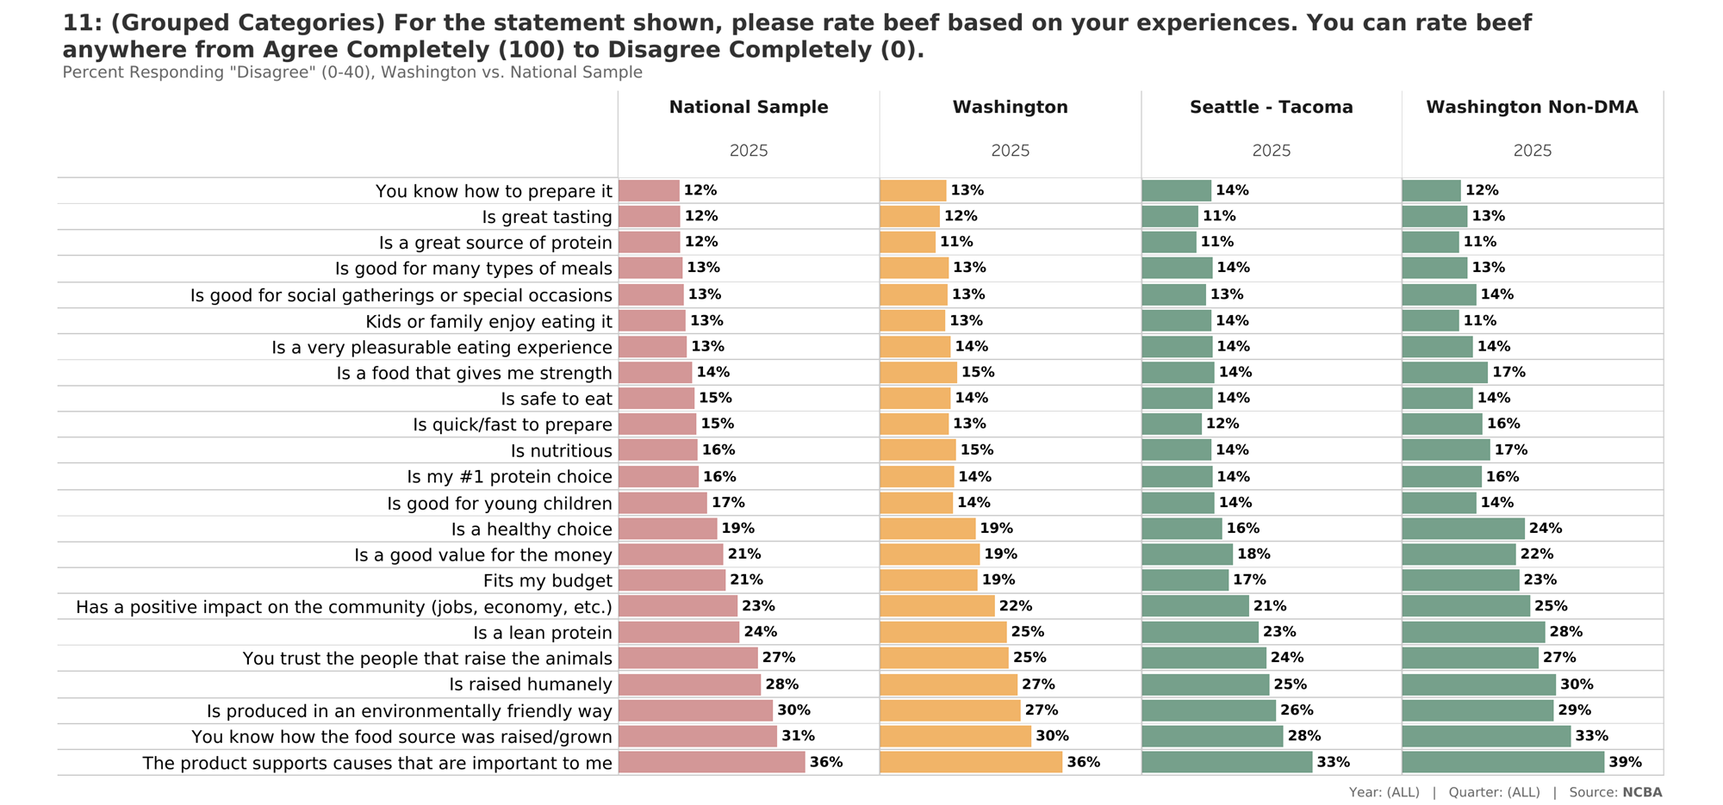
Beef Attributes: Disagree (Bottom 4 Box)

Slide 8
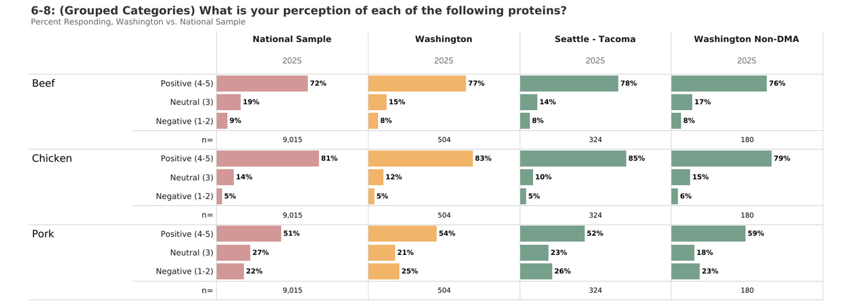
Overall Perceptions

Slide 9
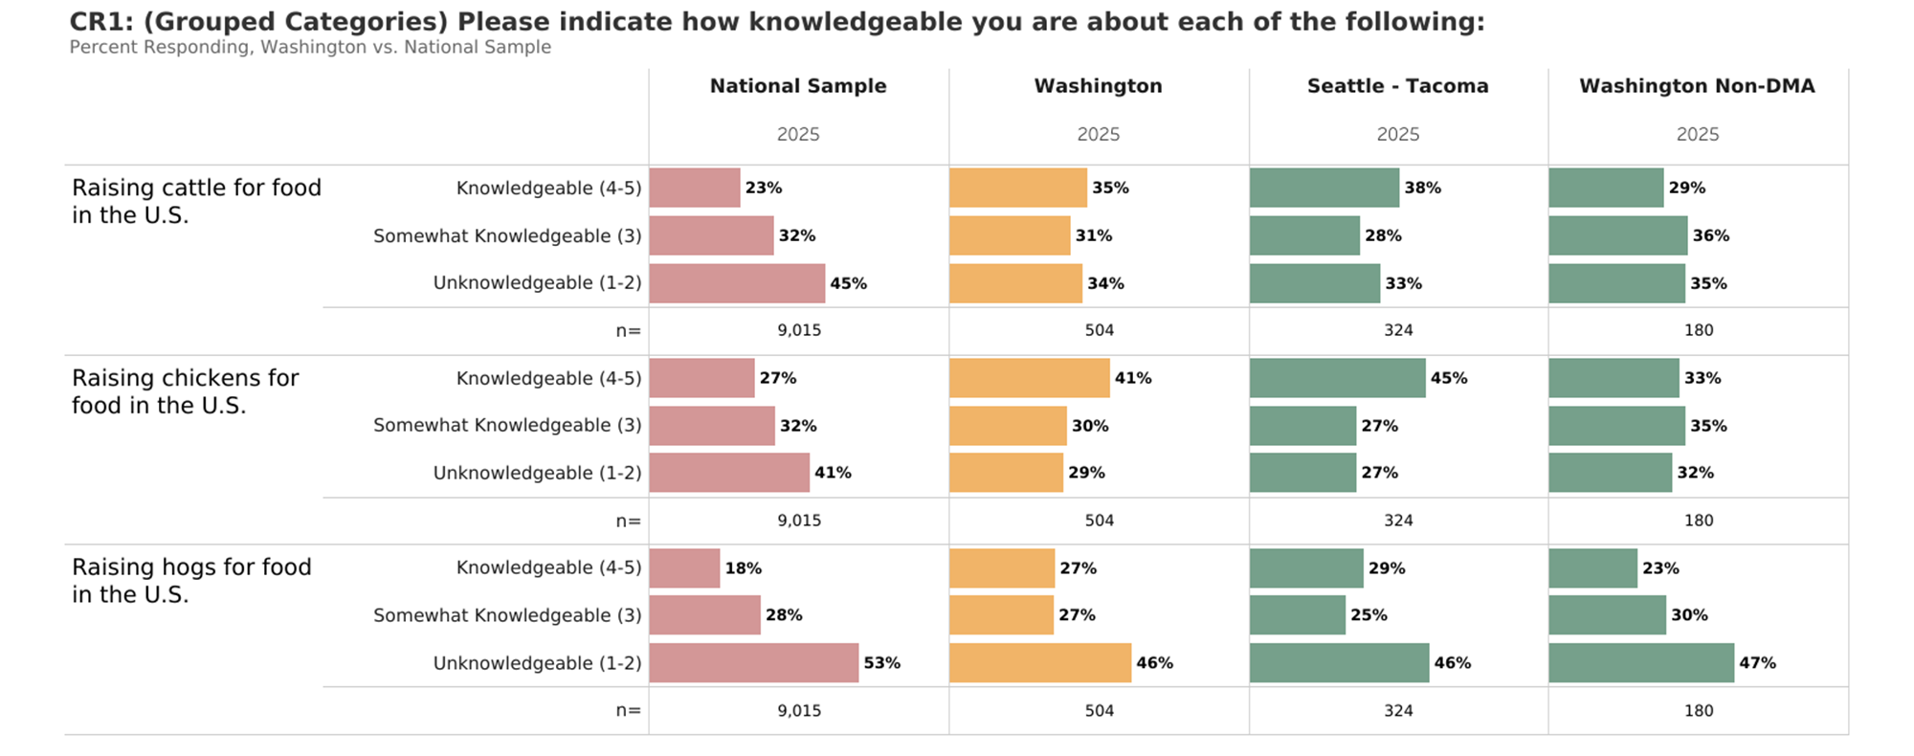
Production Knowledge

Slide 10
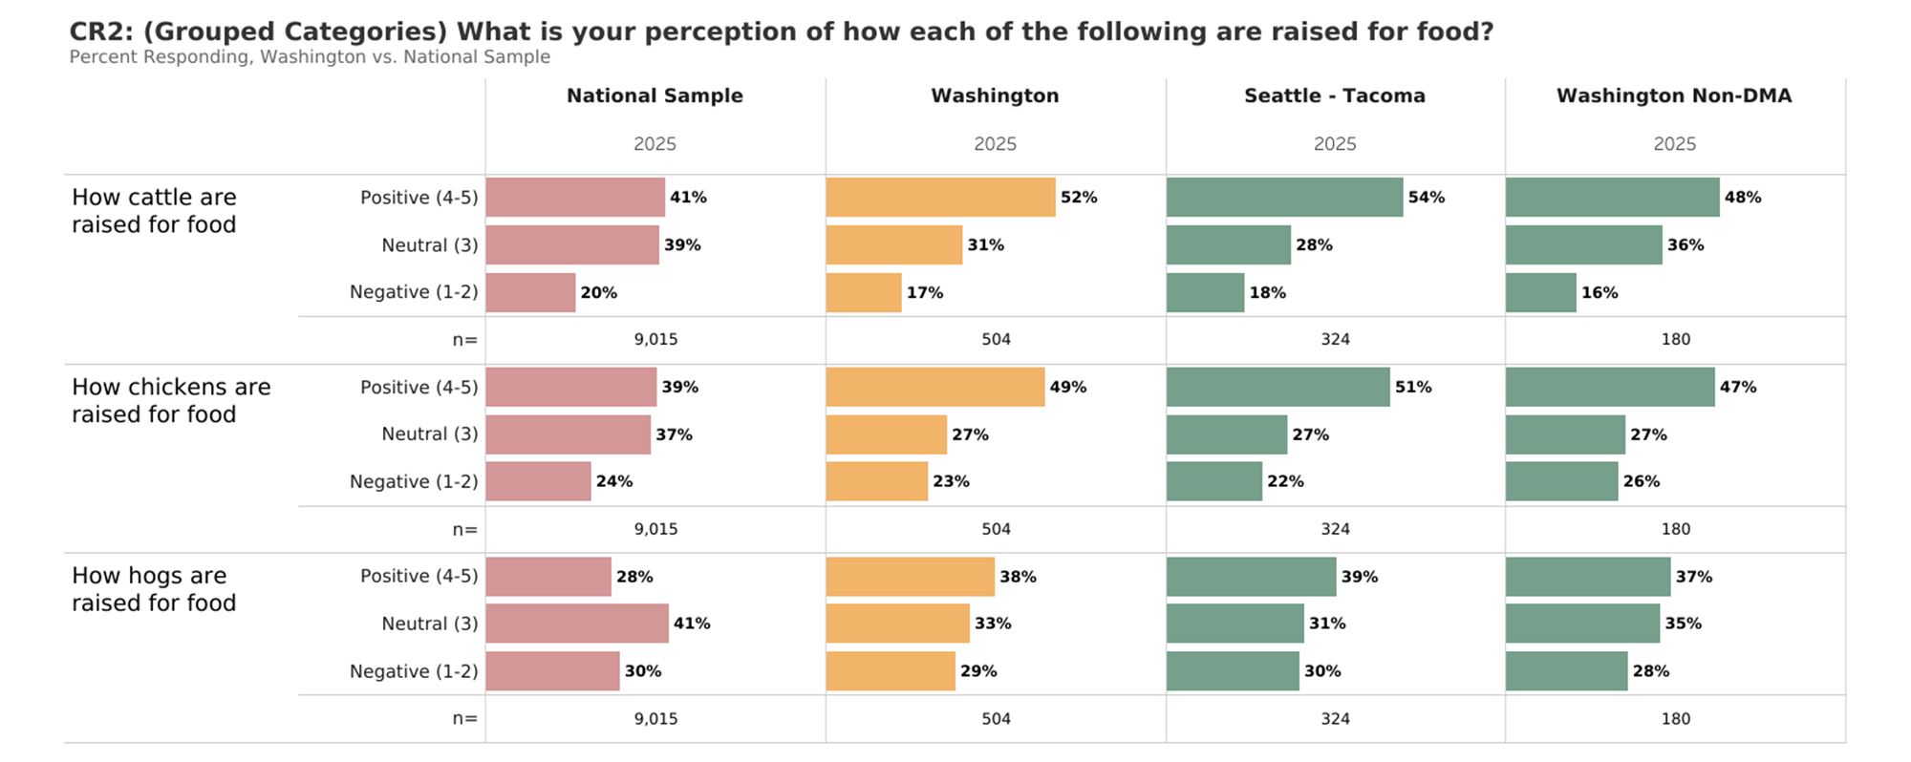
Production Perceptions

Slide 11
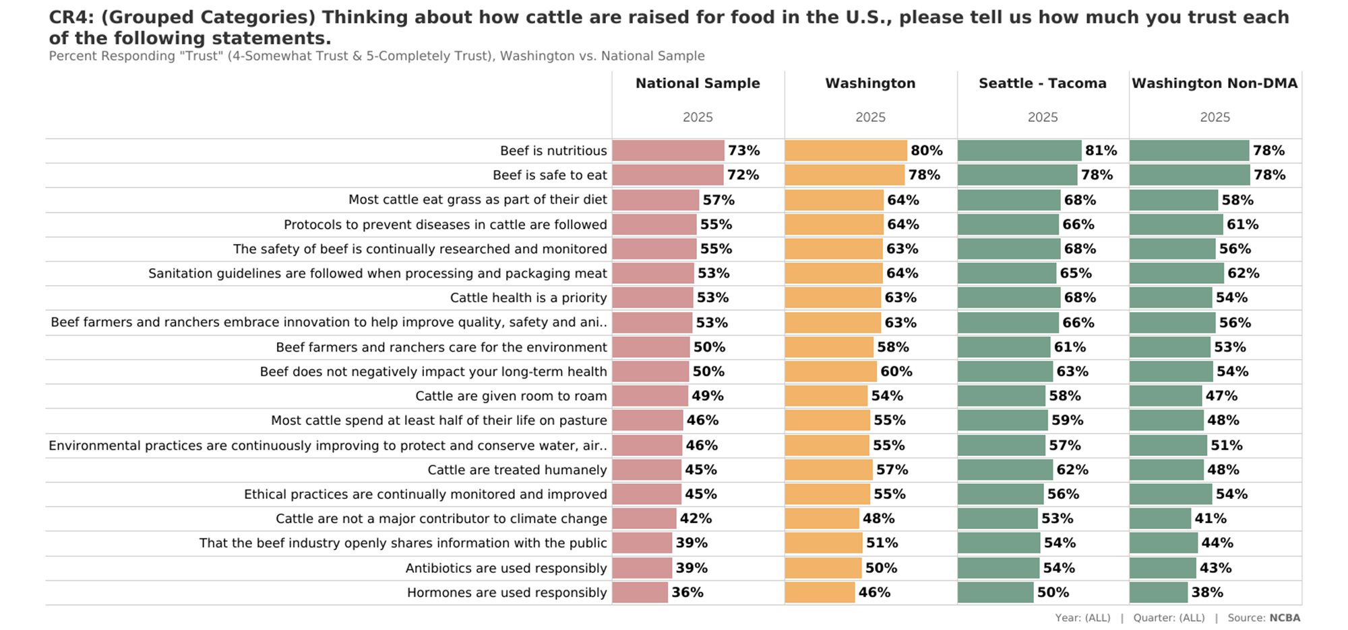
Trust Metrics: How Cattle are Raised for Food: Trust (Top 2 Box)

Slide 12
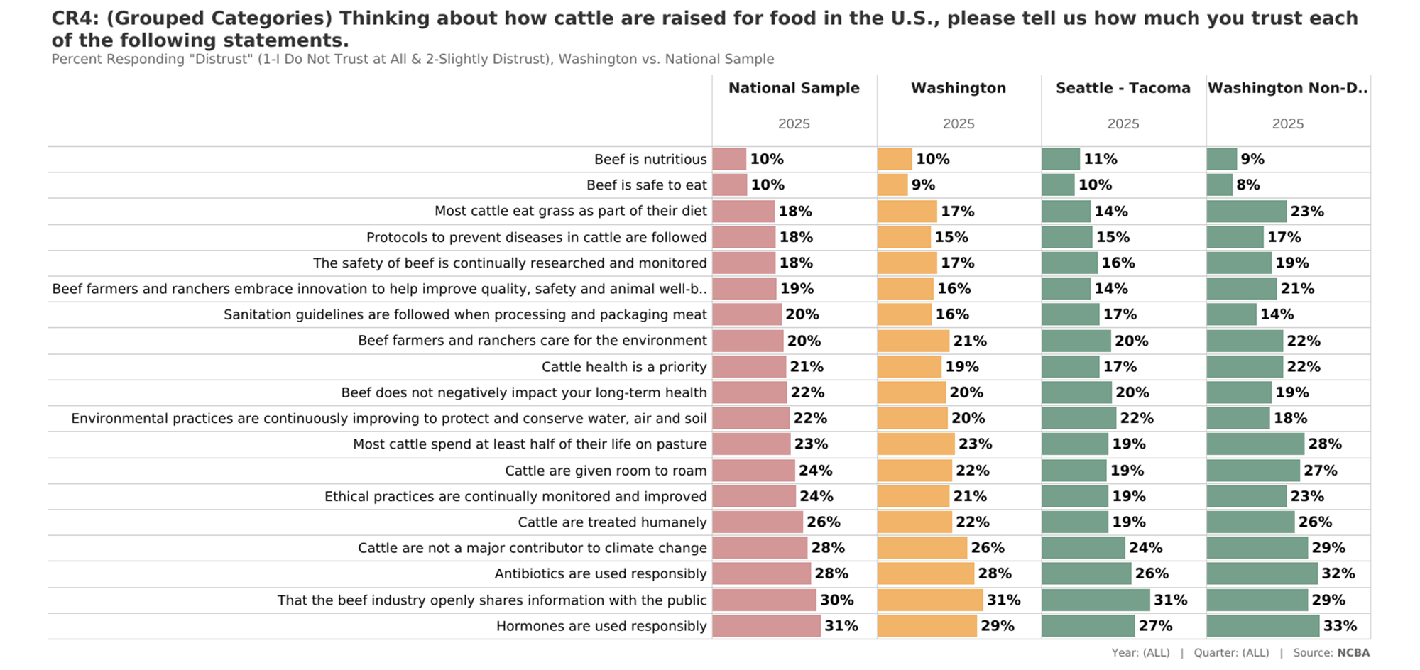
Trust Metrics: How Cattle are Raised for Food: Distrust (Bottom 2 Box)

Slide 13
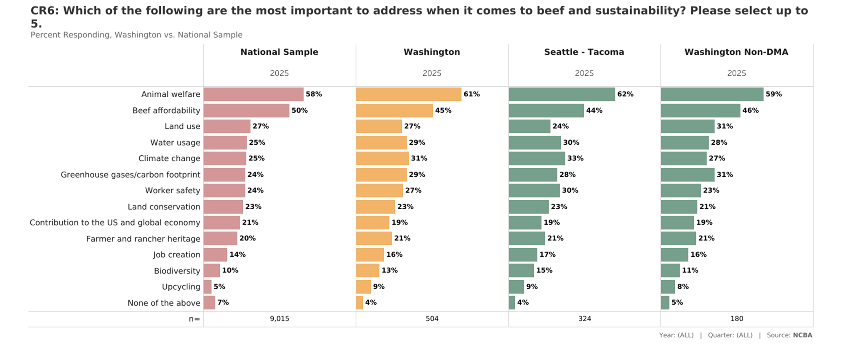
Most Important Topics Related to Beef & Sustainability

Slide 14
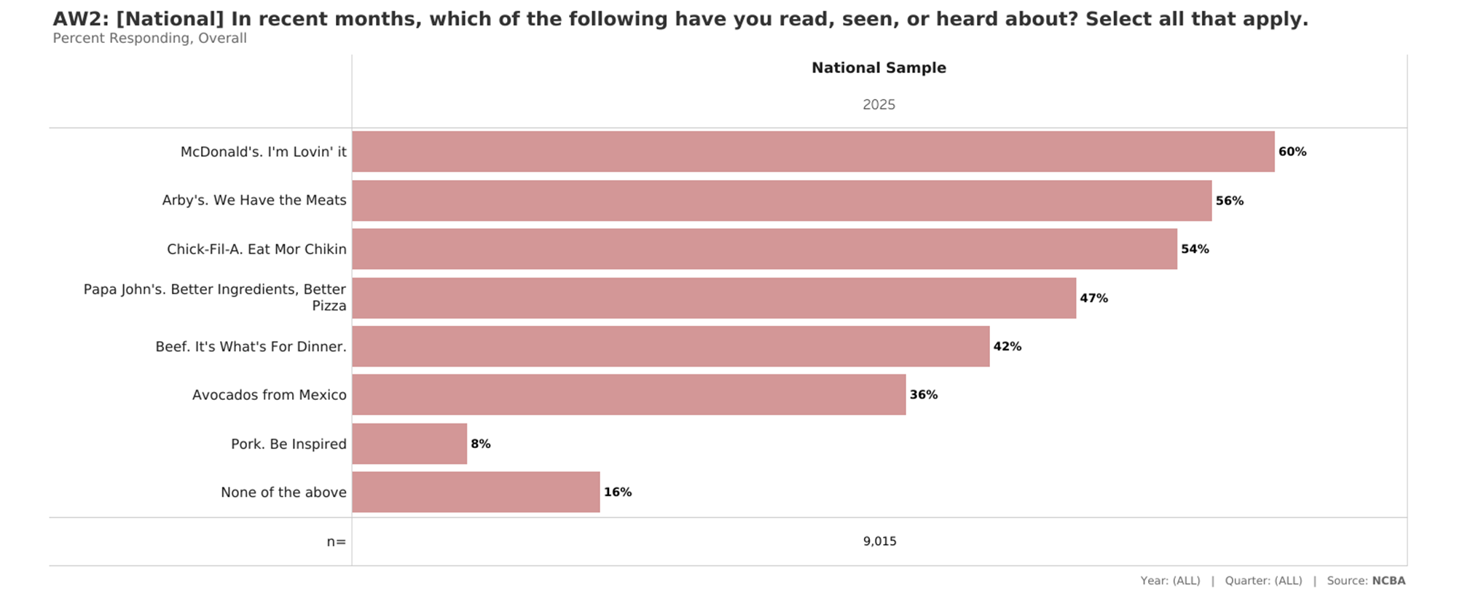
Brand Awareness: National

Slide 15
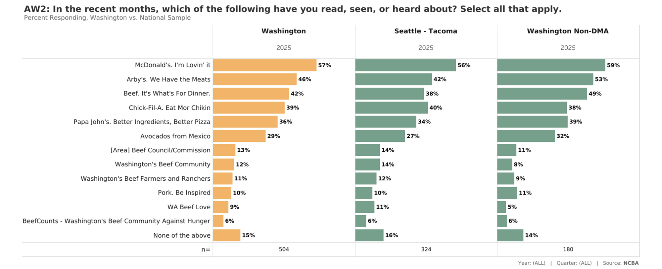
Brand Awareness: State-Specific

Slide 16

Fresh Meat Sales at Retail: 52 Weeks Ending 12/28/2025 Versus Year Ago
$ 52 wks Ending 12/28 v. YAGO |  | LBS. 52 wks Ending 12/28 v. YAGO
National | Washington | National | Washington
+12.4% $45B v. $40.1B | +12.0% $1.1B v. $992M | +4.3% 6.2B v. 6.0B lbs. | +4.7% 138M v. 132M lbs.
+6.5% $20.7B v. $19.4B | +6.6% $465M v. $436M | +3.2% 6.5B v. 6.3B lbs. | +3.7% 136M v. 131M lbs.
+3.3% $8.72B v. $8.5B | +1.9% $186M v. $183M | +1.1% 2.7B v. 2.64B lbs. | -0.5% 56.9M v. 57.1M lbs.
-11.1% $223M v. $262M | N/A | -8.8% 34.3M v. 38M lbs. | N/A
Retail Fresh Meat Sales, 2024 ending 11/3/24
Total Fresh Meat Sales Growth in Dollars (US)
+9.1%
(~$79.5 Billion)
+3.0%
(~16.9 Billion lbs.)
+6.7%
$ sales growth
+3.2%
Lbs. sales growth
Lbs. Sales Growth
Source: Circana, Fresh Beef Sales by Volume and Value, Data Ending 12/28/2025.
Analysis: National Cattlemen’s Beef Association, a contractor to the Beef Checkoff.

Slide 17
Washington Update – 52 Week Ending 12/28/2025
PRODUCT | Current $ Sales | % Change vs YA | Current Lbs. Sold | % Change vs YA | Current Price/Pnd | % Change vs YA
AISLE-FRESH MEAT | $1,891,223,976 | 8.8% | 361,389,427 | 2.5% | $5.23 | 6.2%
BEEF | $1,111,179,858 | 12.0% | 138,384,338 | 4.7% | $8.03 | 7.0%
BEEF STEAKS | $444,886,715 | 9.7% | 38,458,653 | 0.8% | $11.57 | 8.8%
BEEF FRESH GROUND | $304,278,773 | 10.6% | 47,757,963 | 2.3% | $6.37 | 8.2%
BEEF ROAST | $125,455,826 | 10.0% | 18,483,231 | 6.4% | $6.79 | 3.4%
BEEF BRISKET | $16,814,030 | 13.4% | 3,383,264 | 2.3% | $4.97 | 10.8%
BEEF VALUE ADD | $98,585,697 | 11.5% | 13,985,312 | 6.2% | $7.05 | 5.0%
CHICKEN | $464,572,875 | 6.6% | 135,618,836 | 3.7% | $3.43 | 2.8%
TURKEY | $72,757,186 | 1.2% | 22,870,532 | -7.8% | $3.18 | 9.7%
PORK | $185,901,917 | 1.9% | 56,864,843 | -0.5% | $3.27 | 2.3%
Source: Circana retail performance among 40 states, Fresh Beef Sales by Volume, Value and Price, Data Ending 12/28/2025
Per capita calculations based on US Census 2025 Projections – Washington – 8,001,020
Analysis: National Cattlemen’s Beef Association, a contractor to the Beef Checkoff.

Slide 19
Appendix

Slide 20
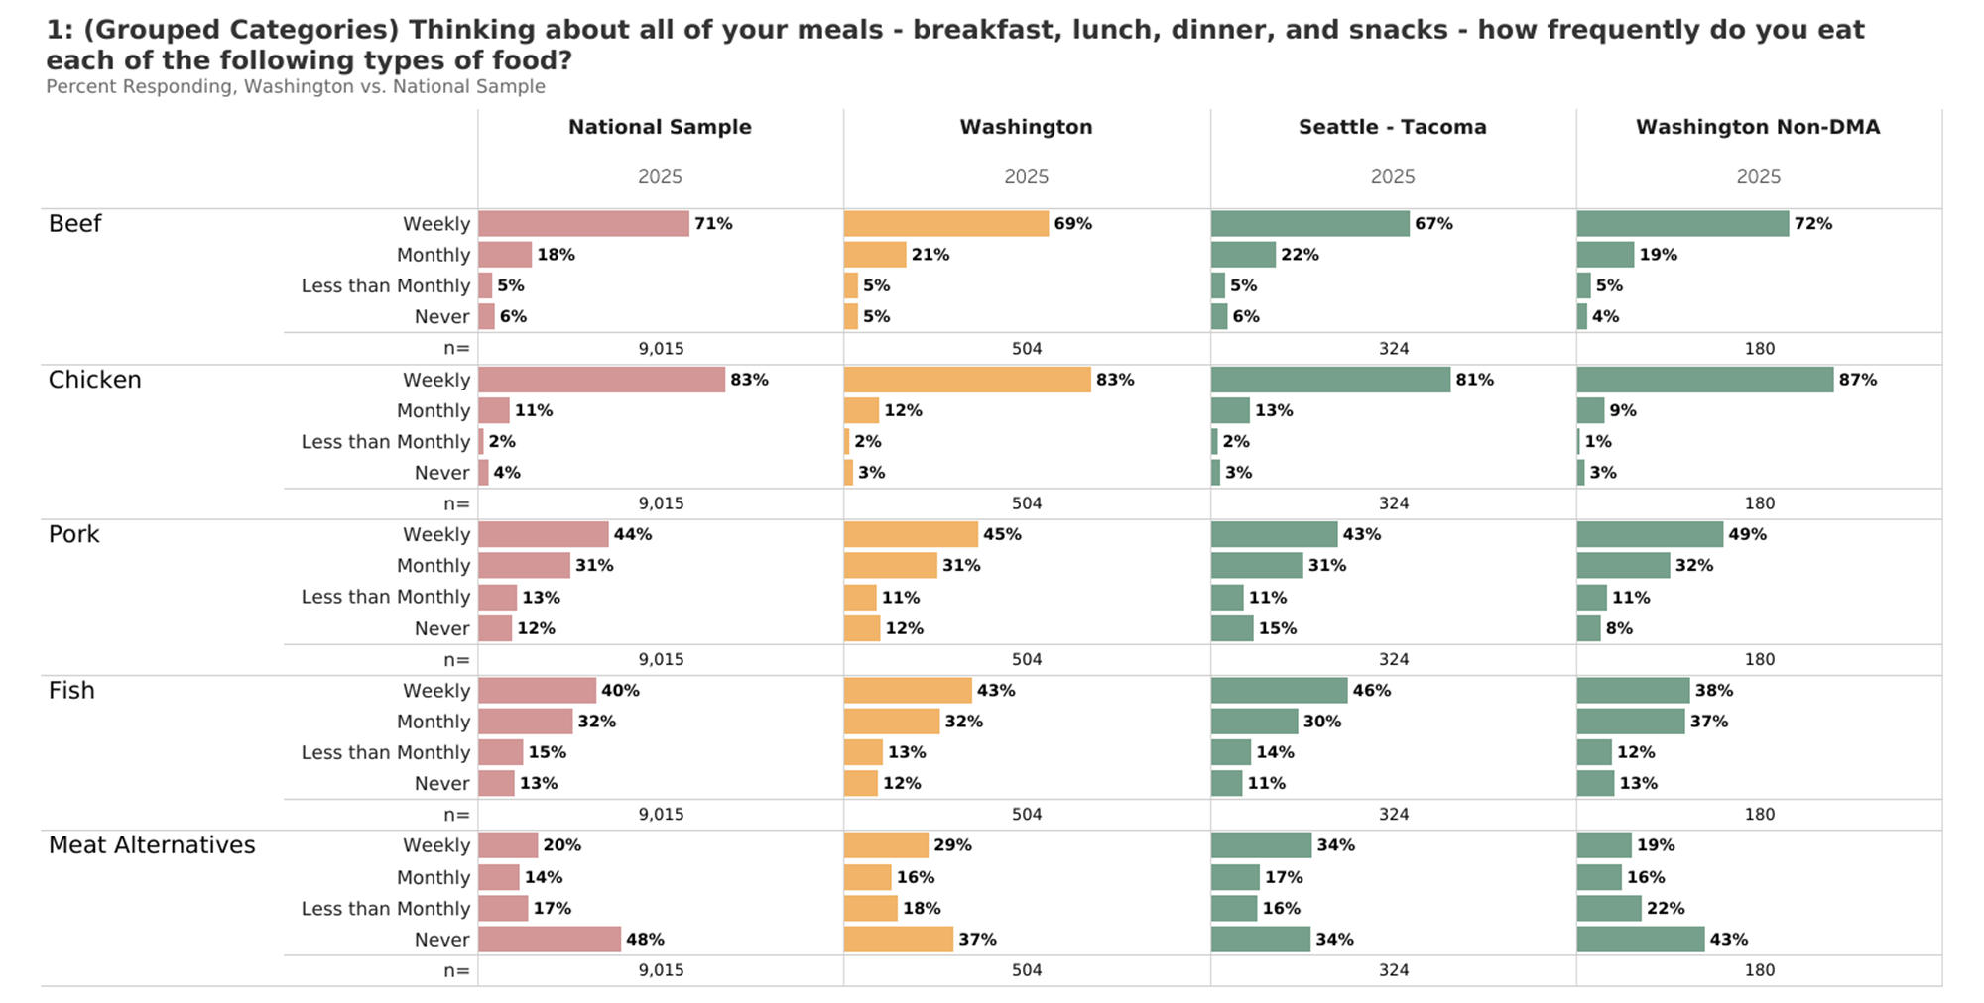
Protein Consumption

Slide 21
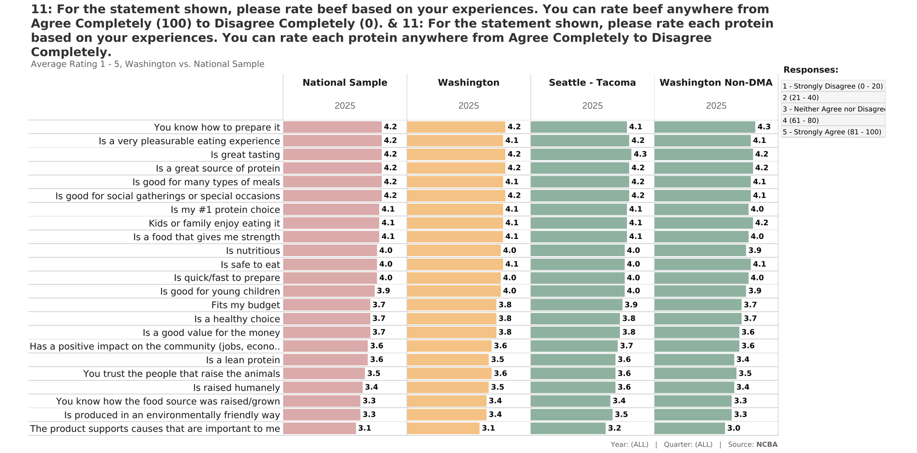
Beef Attributes: Average Rating

Slide 22
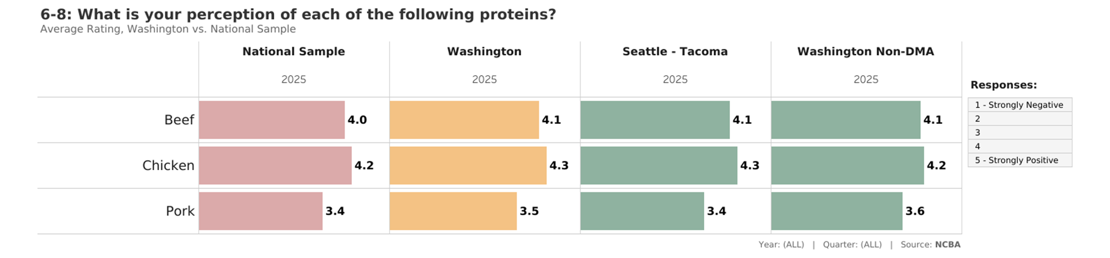
Overall Perceptions: Average Rating

Slide 23
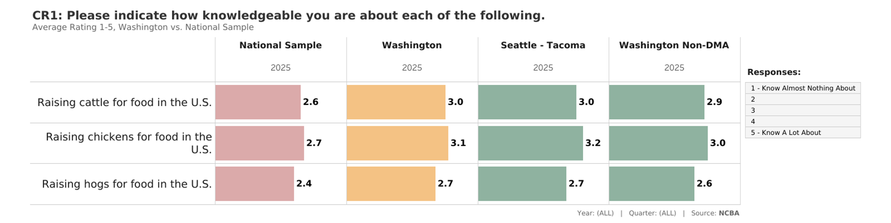
Production Knowledge: Average Rating

Slide 24
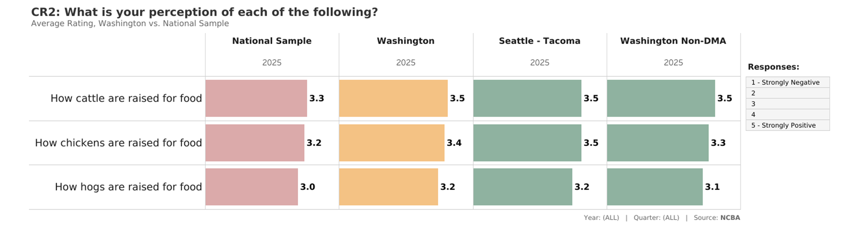
Production Perceptions: Average Rating

Slide 25
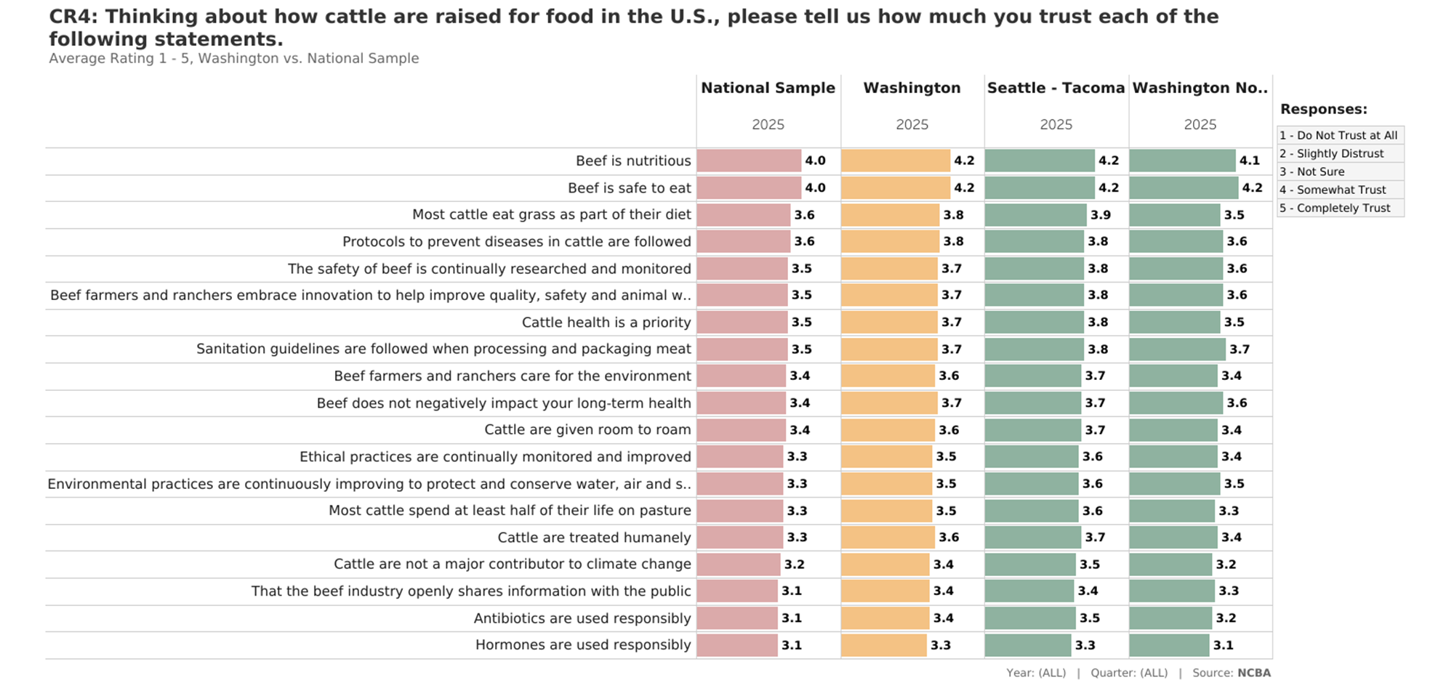
Trust Metrics: How Cattle are Raised for Food: Average Rating

